Slide 1
Portable Insulin Cooler
Joesphan Lu

Slide 2
Design Overview
There is a large population of diabetic citizens
Doses of insulin every day are a necessity
Long-term portable methods of insulin storage are very expensive
The Portable Insulin Cooler is an affordable insulin storage device

Slide 3

Top Level Design

Slide 4
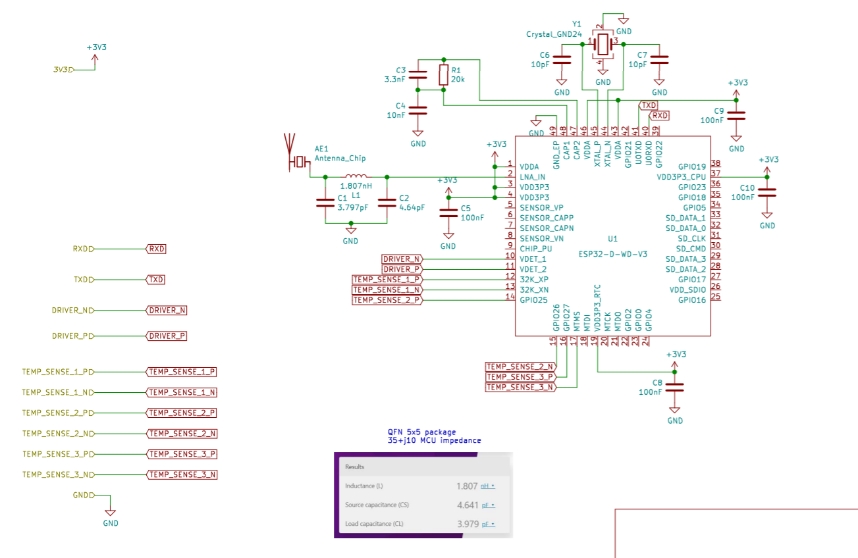
MCU

Slide 5

Ports

Slide 6

Power Management

Slide 7

Temperature Sensors

Slide 8

MOSFETS/Drivers

